Slide 1
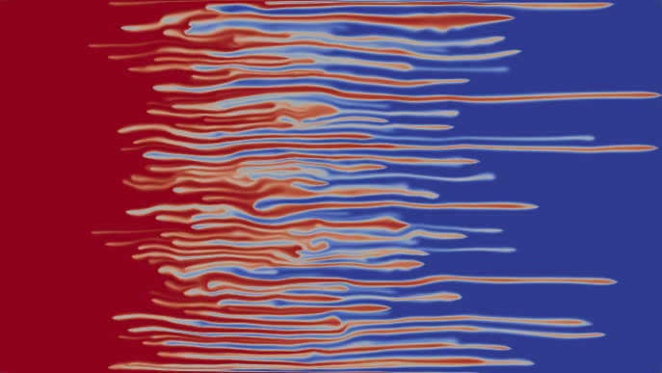

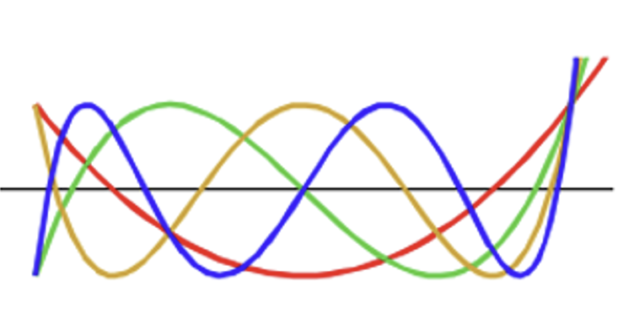



On the linear growth of the mixing zone in a semi-discrete model of Incompressible Porous Medium (IPM) eq
Yulia Petrova PUC-Rio, Rio de Janeiro, Brazil
yulia-petrova.github.io
11 June 2024
Alma mater:
St. Petersburg State University, Russia
Based on:
Yu. Petrova, S. Tikhomirov, Ya. Efendiev, arXiv: 2401.05981 “Propagating terrace in a two-tubes model of gravitational fingering”
F. Bakharev, A. Enin, S. Matveenko, D. Pavlov, Yu. Petrova, N. Rastegaev, S. Tikhomirov, arXiv:2310.14260
“Velocity of viscous fingers in miscible displacement: Intermediate concentration”

Slide 2
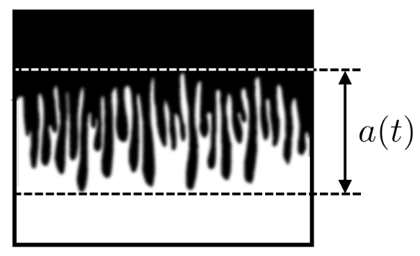
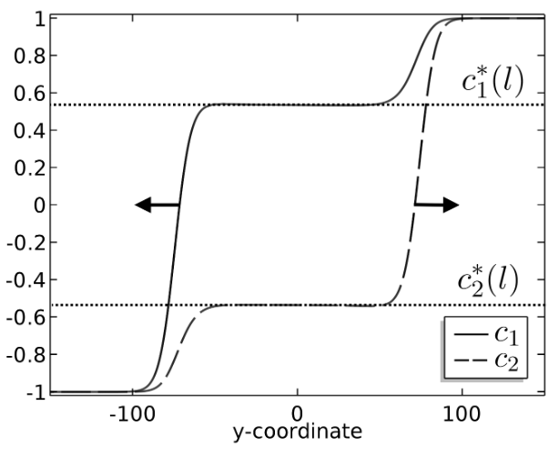
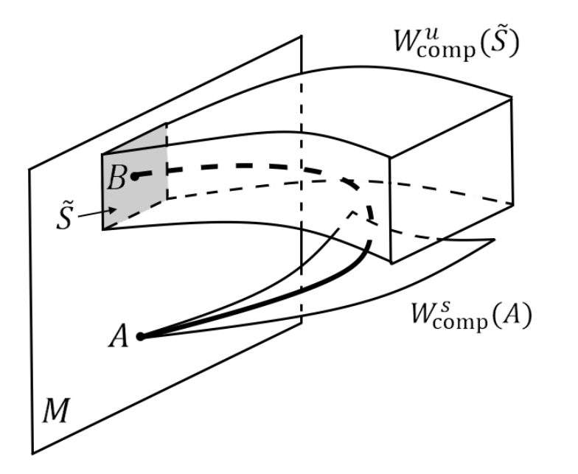
Outline
Motivation
Miscible displacement in porous media:
viscous fingering
gravitational fingering
Problem statement
Two-tubes model
Main theorem
Sketch of the proof of the main theorem
Traveling waves
Geometric singular perturbation theory

Slide 3
“Miscible displacement in porous media”
Credit: Pavlov Dmitrii, St. Petersburg State University
Homsy , 1987 “Viscous Fingering in Porous Media”
Viscous fingering phenomenon
water (blue color) polymerized water (red color)
1

Slide 4
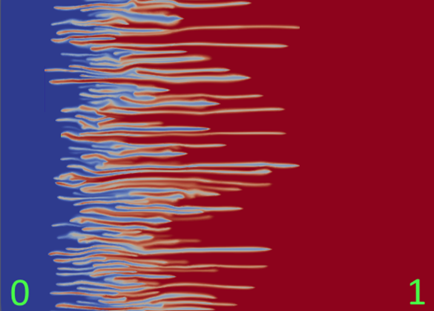
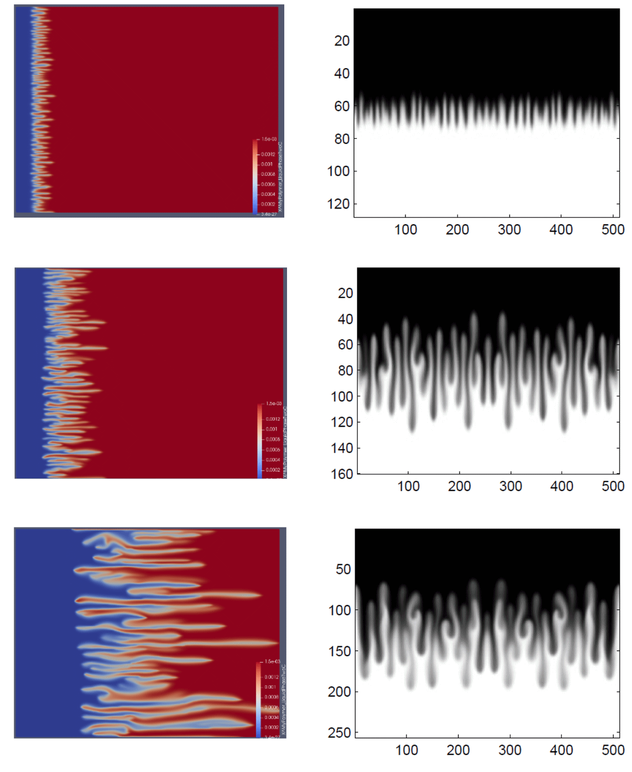
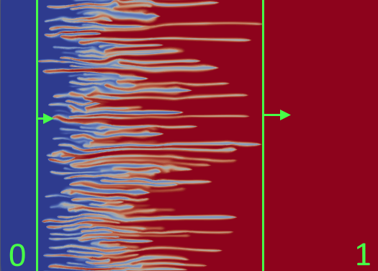
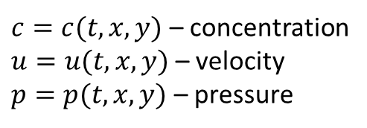
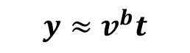
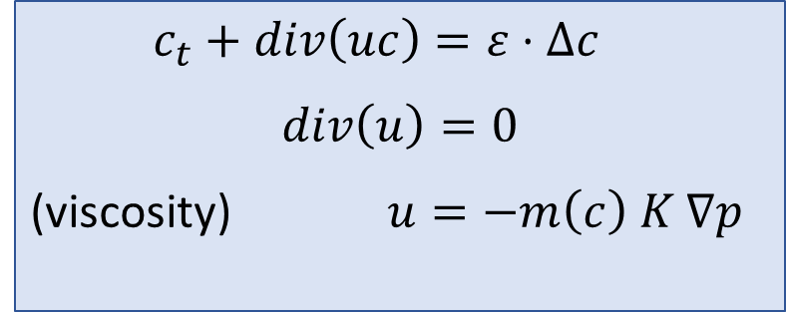



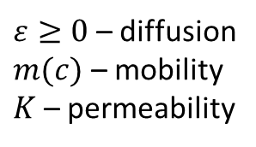
Incompressible Porous Medium eq – IPM, 2D (Two formulations)
Viscous fingering
Gravitational fingering
$c_{t}+div\left(uc\right)=ε⋅Δc$
$$div\left(u\right)=0$$
(viscosity) $u=−m\left(c\right) K ∇p$
1
$$y≈v^{f}t$$
$$x≈v^{b}t$$
$$x≈v^{f}t$$
(gravity) $u=−∇p−(0,c)$
$c=c(t,x,y)$ – concentration
$u=u(t,x,y)$ – velocity
$p=p(t,x,y)$ – pressure
$ε≥0$ – diffusion
$m(c)$ – mobility
$K$ – permeability
-1
$$y≈v^{b}t$$
mixing zone
[1], [2]
many laboratory and numerical experiments show linear growth of the mixing zone
Question: how to find speeds $v^{b}$ and $v^{f}$ of propagation?
Industrial application: 2022 – patent (Russia)
[1] Nijjer J., Hewitt D., and Neufeld J. The dynamics of miscible viscous fingering from onset to shutdown. Journal of Fluid Mechanics, 2018.
[2] Bakharev, F., Enin, A., Groman, A., Kalyuzhnyuk, A., Matveenko, S., Petrova, Y., Starkov, I. and Tikhomirov, S., Velocity of viscous fingers in miscible displacement: Comparison with analytical models. Journal of Computational and Applied Mathematics, 2022.
2
industrial application:
optimization of injection schemes in chemical enhanced oil recovery methods

Slide 5
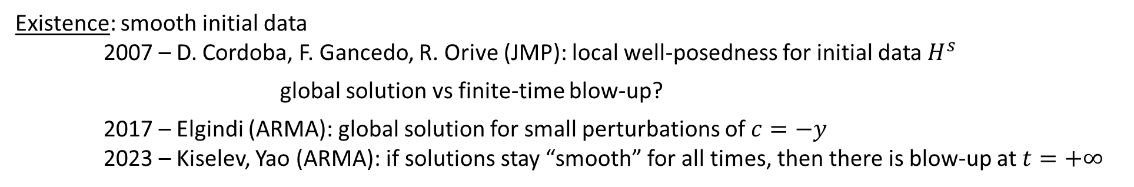
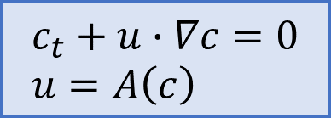
IPM: $ε=0 \text{(}\text{without} \text{diffusion}\text{)}$
$$c_{t}+u∙∇c=0 \\ u=A\left(c\right)$$
Active scalar:
$u=∇^{⊥}{\left(−Δ\right)}^{−1}∂_{1}c$ (Biot-Savart law)
Discontinuous initial data: free boundary problem (Muskat problem) – ill-posed for unstable stratification 2011 - A. Córdoba, D. Córdoba, F. Gancedo (Annals of Mathematics) “Interface evolution: the Hele-Shaw and Muskat problems”
Existence: smooth initial data
2007 – D. Cordoba, F. Gancedo, R. Orive (JMP): local well-posedness for initial data $H^{s}$ global solution vs finite-time blow-up?
2017 – Elgindi (ARMA): global solution for small perturbations of $c=−y$
2023 – Kiselev, Yao (ARMA): if solutions stay “smooth” for all times, then there is blow-up at $t=+∞$
open
Uniqueness: non-uniqueness of weak solutions – by convex integration
2011 – Córdoba, Faraco, Gancedo (ARMA)
2012 – L. Szekelyhidi Jr.
…and many others…
3
[2] Bakharev, F., Enin, A., Groman, A., Kalyuzhnyuk, A., Matveenko, S., Petrova, Y., Starkov, I. and Tikhomirov, S., Velocity of viscous fingers in miscible displacement: Comparison with analytical models. Journal of Computational and Applied Mathematics, 2022.
[6] Bakharev F., Enin A., Matveenko S., Rastegaev N., Pavlov D., Tikhomirov S. Relation between size of mixing zone and intermediate concentration in
miscible displacement. arXiv:2310.14260
Neglect advection in transverse direction!

Slide 6
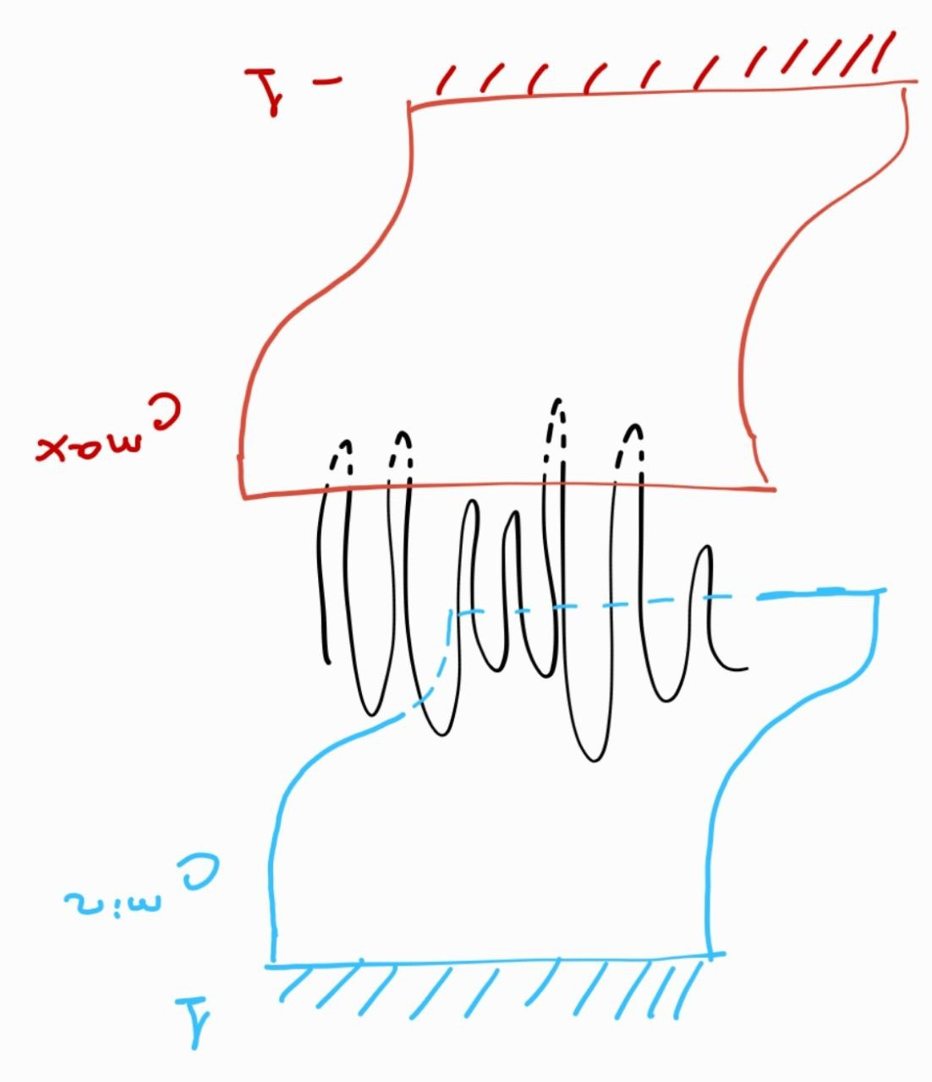
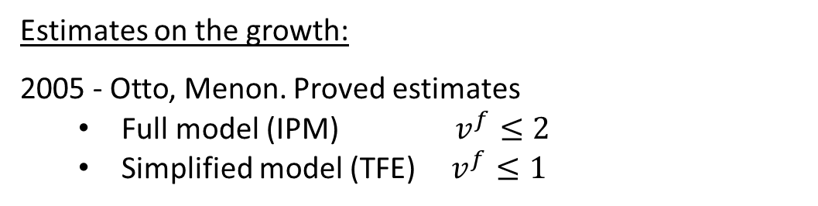
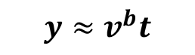

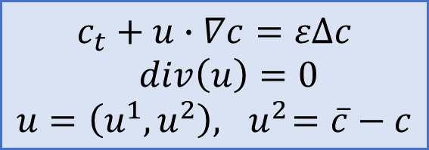
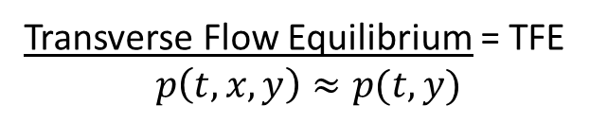
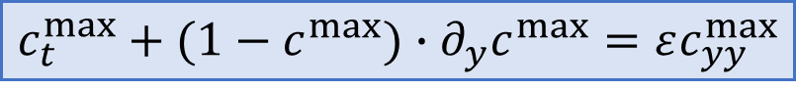
IPM: $ε>0$ (with diffusion)
Estimates on the growth:
2005 - Otto, Menon. Proved estimates
Full model (IPM) $v^{f}≤2$
Simplified model (TFE) $v^{f}≤1$
1
$$y≈v^{f}t$$
$$c_{t}+u∙∇c=εΔc$$
$div\left(u\right)=0$ $$u=\left(u^{1},u^{2}\right), { u}^{2}=\overline{c}−c$$
Transverse Flow Equilibrium = TFE $$p\left(t,x,y\right)≈p(t,y)$$
-1
$$y≈v^{b}t$$
Idea of proof (TFE): comparison to 1D Burgers eq ($\overline{c}≤1$ then $u^{2}≤1−c$)
[2]
$$c_{t}^{max}+(1−c^{max})∙∂_{y}c^{max}=εc_{yy}^{max}$$
Theorem (Otto, Menon): If $c\left(0,x,y\right)≤c^{max}(0,y)$,
then $c\left(t,x,y\right)≤c^{max}(t,y)$ for any $t>0$.
Question: Are those estimates sharp?
4
[2] Bakharev, F., Enin, A., Groman, A., Kalyuzhnyuk, A., Matveenko, S., Petrova, Y., Starkov, I. and Tikhomirov, S., Velocity of viscous fingers in miscible displacement: Comparison with analytical models. Journal of Computational and Applied Mathematics, 2022.
[6] Bakharev F., Enin A., Matveenko S., Rastegaev N., Pavlov D., Tikhomirov S. Relation between size of mixing zone and intermediate concentration in
miscible displacement. arXiv:2310.14260
Neglect advection in transverse direction!

Slide 7
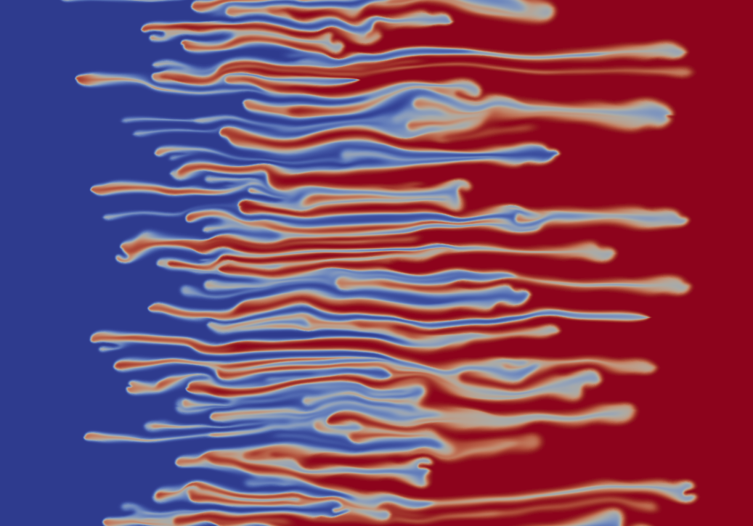
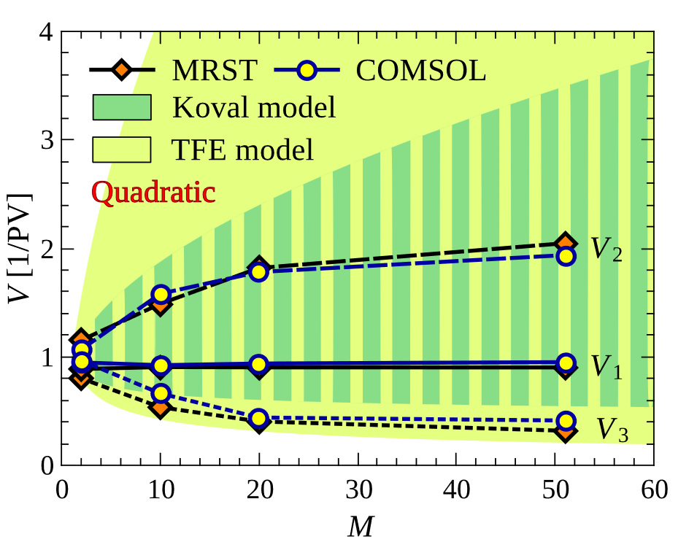
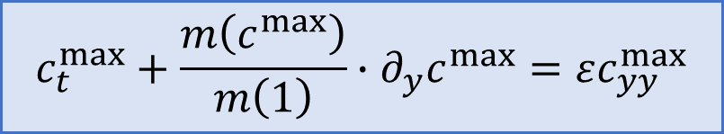
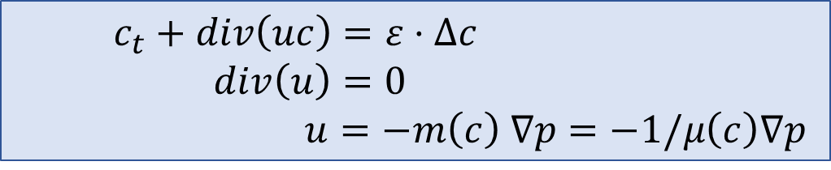
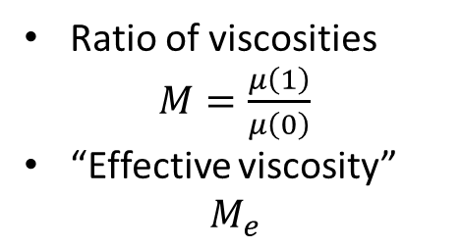
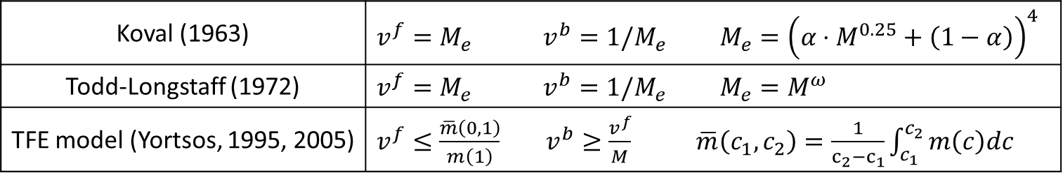
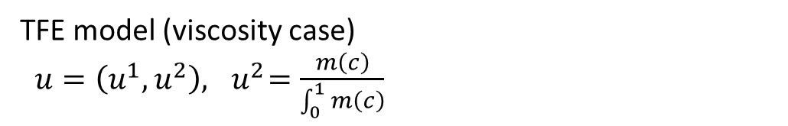
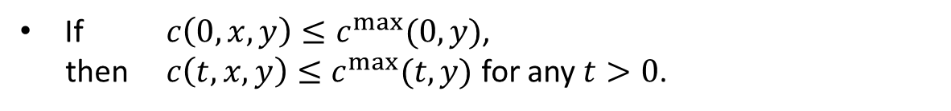
Viscosity-driven fingers
$c_{t}+div\left(uc\right)=ε⋅Δc$
$div\left(u\right)=0$ $u=−m\left(c\right) ∇p=−1/μ\left(c\right)∇p$
TFE model (viscosity case)
$u=\left(u^{1},u^{2}\right), { u}^{2}=\frac{m\left(c\right)}{\int_{0}^{1}{m\left(c\right)}}$
Empirical models of velocities:
Koval (1963) | $$v^{f}=M_{e} v^{b}=1/M_{e} M_{e}={\left(α⋅M^{0.25}+\left(1−α\right)\right)}^{4}$$
Todd-Longstaff (1972) | $$v^{f}=M_{e} v^{b}=1/M_{e} M_{e}=M^{ω}$$
TFE model (Yortsos, 1995, 2005) | $v^{f}≤\frac{\overline{m}\left(0,1\right)}{m\left(1\right)} v^{b}≥\frac{v^{f}}{M}$ $\overline{m}\left(c_{1},c_{2}\right)=\frac{1}{c_{2}−c_{1}}\int_{c_{1}}^{c_{2}}{m\left(c\right)dc}$
Ratio of viscosities
$M=\frac{μ\left(1\right)}{μ\left(0\right)}$
“Effective viscosity” $M_{e}$
Yortsos, Salin (2006): comparison to Burgers-type 1D eq:
$$c_{t}^{max}+\frac{m\left(c^{max}\right)}{m\left(1\right)}∙∂_{y}c^{max}=εc_{yy}^{max}$$
TFE estimates are too pessimistic!
If $c\left(0,x,y\right)≤c^{max}(0,y)$,
then $c\left(t,x,y\right)≤c^{max}(t,y)$ for any $t>0$.
Question: Are those estimates sharp?
5
Neglect advection in transverse direction!

Slide 8
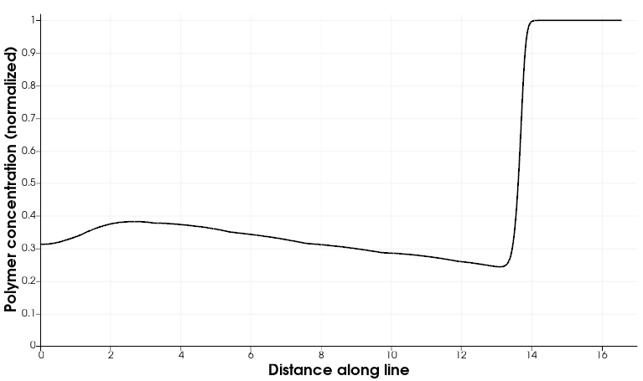
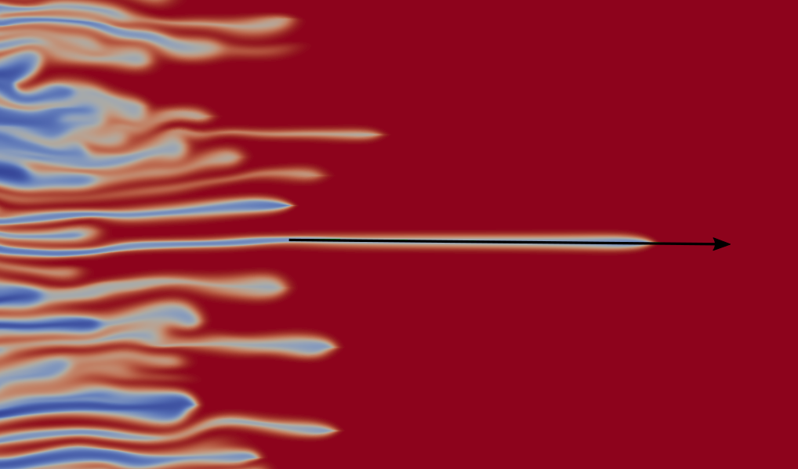
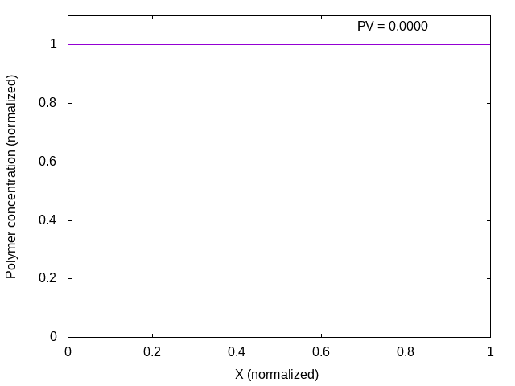
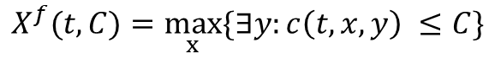
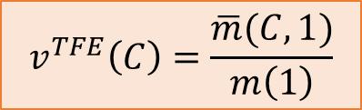
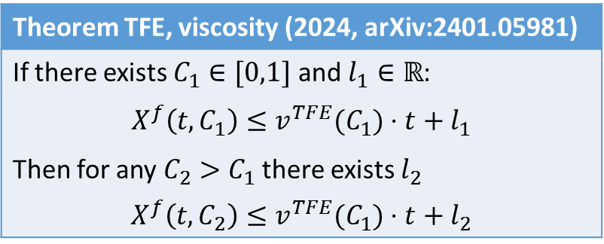
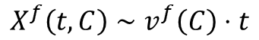
Viscosity-driven fingers
$c_{t}+div\left(uc\right)=ε⋅Δc$
$div\left(u\right)=0$ $u=−m\left(c\right) ∇p=−1/μ\left(c\right)∇p$
TFE model (viscosity case)
$u=\left(u^{1},u^{2}\right), { u}^{2}=\frac{m\left(c\right)}{\int_{0}^{1}{m\left(c\right)}}$
Empirical models of velocities:
Koval (1963) | $$v^{f}=M_{e} v^{b}=1/M_{e} M_{e}={\left(α⋅M^{0.25}+\left(1−α\right)\right)}^{4}$$
Todd-Longstaff (1972) | $$v^{f}=M_{e} v^{b}=1/M_{e} M_{e}=M^{ω}$$
TFE model (Yortsos, 1995, 2005) | $v^{f}≤\frac{\overline{m}\left(0,1\right)}{m\left(1\right)} v^{b}≥\frac{v^{f}}{M}$ $\overline{m}\left(c_{1},c_{2}\right)=\frac{1}{c_{2}−c_{1}}\int_{c_{1}}^{c_{2}}{m\left(c\right)dc}$
Ratio of viscosities
$M=\frac{μ\left(1\right)}{μ\left(0\right)}$
“Effective viscosity” $M_{e}$
What could be a mechanism of slow-down?
Theorem TFE, viscosity (2024, arXiv:2401.05981)
If there exists $C_{1}∈[0,1]$ and $l_{1}∈ℝ$: $$X^{f}\left(t, C_{1}\right)≤v^{TFE}(C_{1})⋅t+l_{1}$$ Then for any $C_{2}>C_{1}$ there exists $l_{2}$ $$X^{f}\left(t, C_{2}\right)≤v^{TFE}(C_{1})⋅t+l_{2}$$
$$X^{f}(t, C)=\max_{x}{\{∃y:c\left(t, x, y\right) ≤C\}}$$
$$X^{f}\left(t, C\right)∼v^{f}\left(C\right)⋅t$$
$$v^{TFE}\left(C\right)=\frac{\overline{m}(C,1)}{m\left(1\right)}$$
5
Neglect advection in transverse direction!

Slide 9
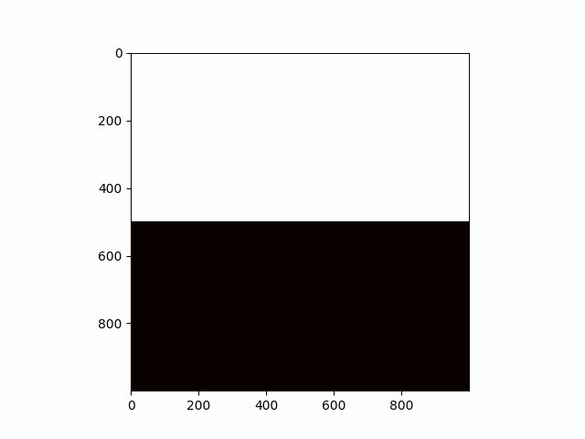
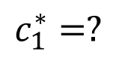
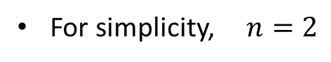
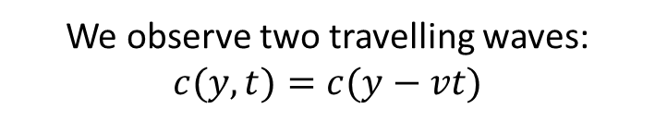
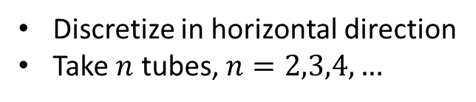
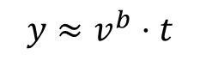
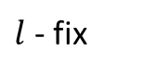
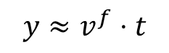

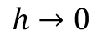
IDEA: semi-discrete model of gravitational fingering
Discretize in horizontal direction
Take $n$ tubes, $n=2,3,4,…$
Limit of
numerical scheme
For simplicity, $n=2$
1
1
$$y≈v^{f}⋅t$$
$$h→0$$
$$c_{1}^{∗}=?$$
$$c_{2}^{∗}=?$$
$$y≈v^{b}⋅t$$
-1
-1
$l$ - fix
Finite volume
Upwind
We observe two travelling waves: $c(y,t)=c(y−vt)$
Tubes (layer, lane,…) models:
2019 — A. Armiti-Juber, C. Rohde “On Darcy- and Brinkman-type models for two-phase flow in asympt. flat domains”
2006 — J.C. Da Mota, S. Schecter “Combustion fronts in a porous medium with two layers”
2019 — H. Holden, N. Risebro “Models for dense multilane vehicular traffic”
6
2005 – Otto, Menon: pointwise estimates for simplified model

Slide 10
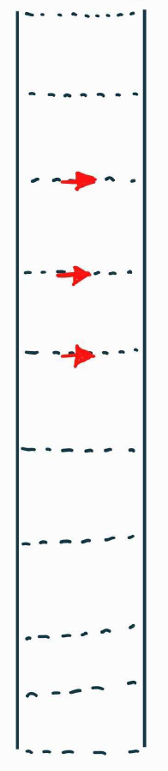
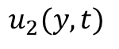
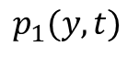
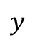

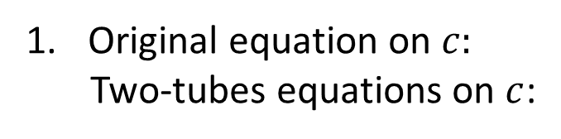
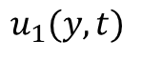
















Two-tubes model
Original equation on $c:$
Two-tubes equations on $c$:
$$y$$
$$c_{t}+div\left(uc\right)− ∆c=0$$
$$c_{1}(y, t)$$
$$c_{2}(y, t)$$
$$B$$
$$∂_{t}c_{1}+∂_{y}\left(u_{1}c_{1}\right)−∂_{yy}c_{1}=−B$$
$$∂_{t}c_{2}+∂_{y}\left(u_{2}c_{2}\right)−∂_{yy}c_{2}=+B$$
$$u_{1}(y, t)$$
$$w(y, t)$$
$$u_{2}(y, t)$$
Original equation on $p:$
Two-tubes equations on $p$:
$$u=−∇p −(0,c)$$
$$p_{1}(y, t)$$
$$p_{2}(y, t)$$
$$u_{1}=−∂_{y}p_{1}−c_{1}$$
$$u_{2}=−∂_{y}p_{2}−c_{2}$$
$l$ - parameter
$$w=\frac{p_{1}−p_{2}}{l^{2}}$$
Original equation on $u$:
Two-tubes equations on $u$:
$$div(u)=0$$
$$B=\left\{\left.\begin{aligned}w⋅c_{1}, w>0, \\ w⋅c_{2}, w<0\end{aligned}\right.\right.$$
$$∂_{y}u_{1}+w=0$$
7

Slide 11




















Main result
The proof is valid only for $l>0$ sufficiently small
Numerics suggests the same statement for $∀l>0$
Moreover, $\lim_{l→0}{c_{1}^{∗}(l)}=−\frac{1}{2}, \lim_{l→0}{c_{2}^{∗}(l)}=\frac{1}{2}$, $\lim_{l→0}{v^{b}(l)}=−\frac{1}{4}, \lim_{l→0}{v^{f}(l)}=\frac{1}{4}.$
$$∂_{t}c_{1}+∂_{y}\left(u_{1}c_{1}\right)− ∂_{yy}c_{1}=−B$$
$$∂_{t}c_{2}+∂_{y}\left(u_{2}c_{2}\right)− ∂_{yy}c_{2}= B$$
$$B=\left\{\left.\begin{aligned}−∂_{y}u_{1}⋅c_{1}, ∂_{y}u_{1}<0, \\ +∂_{y}u_{2}⋅c_{2}, ∂_{y}u_{1}>0\end{aligned}\right.\right.$$
($∗$)
$$u_{1}=−∂_{y}p_{1}−c_{1}$$
Remark:
$$\lim_{l→0}{c_{1}^{∗}\left(l\right)=−0.5}$$
$$\lim_{l→0}{c_{2}^{∗}\left(l\right)=+0.5}$$
$$\lim_{l→0}{v^{b}\left(l\right)=−0.25}$$
$$\lim_{l→0}{v^{f}\left(l\right)=+0.25}$$
$$u_{2}=−∂_{y}p_{2}−c_{2}$$
$$∂_{y}u_{1}=−∂_{y}u_{2}=\frac{p_{2}−p_{1}}{l}$$
As $t→∞$ we observe:
Theorem (Efendiev, P., Tikhomirov, 2024, arXiv: 2401.05981)
Consider a two-tube model with gravity $(∗)$.
$$1$$
$$c_{2}^{∗}(l)$$
there exists $c_{1}^{∗}(l), c_{2}^{∗}(l)$
$c_{1}$ - blue
$c_{2}$ - green
Then for all $l>0$ sufficiently small
such that there exist two travelling waves (TW):
$$c_{1}^{∗}(l)$$
TW1 with speed $v^{b}(l)$: $\left(−1, −1\right) → \left(c_{1}^{∗},(l) c_{2}^{∗}(l)\right)$ TW2 with speed $v^{f}\left(l\right)$: $\left(c_{1}^{∗},(l) c_{2}^{∗}(l)\right) → \left(1, 1\right).$
$$−1$$
8

Slide 12




Many tubes: numerics
The proof is valid only for $l>0$ sufficiently small
Numerics suggests the same statement for $∀l>0$
Moreover, $\lim_{l→0}{c_{1}^{∗}(l)}=−\frac{1}{2}, \lim_{l→0}{c_{2}^{∗}(l)}=\frac{1}{2}$, $\lim_{l→0}{v^{b}(l)}=−\frac{1}{4}, \lim_{l→0}{v^{f}(l)}=\frac{1}{4}.$
3 tubes
4 tubes
7 tubes
Questions:
(1) explain the structure of “asymptotic solutions” for $n$ tubes
(2) find speed of growth of the mixing zone
(3) understand the behaviour as $n→∞$. Do we approximate 2-dim IPM?
(4) can we repeat this story for the many tubes viscous fingering model?
9

Slide 13










Main ingredient in proof: comparison with TFE equations
The proof is valid only for $l>0$ sufficiently small
Numerics suggests the same statement for $∀l>0$
Moreover, $\lim_{l→0}{c_{1}^{∗}(l)}=−\frac{1}{2}, \lim_{l→0}{c_{2}^{∗}(l)}=\frac{1}{2}$, $\lim_{l→0}{v^{b}(l)}=−\frac{1}{4}, \lim_{l→0}{v^{f}(l)}=\frac{1}{4}.$
Step 1: traveling wave ansatz $ξ=y−vt$ ⇒ traveling wave dynamical system (TWDS) – it is a slow-fast system!
$$l=0$$
heteroclinic orbits can be found explicitly!
Orbit $∈W^{s}⋔W^{u}$
+ geometric singular perturbation theory
$$l>0$$
heteroclinic orbits persist under small perturbations
This step is broken for viscous fingers!
This system can be seen a hyperbolic system in
non-conservative form (for fixed choice of $B$) with parabolic regularization:
Two-tubes TFE equations
$$∂_{t}c_{1}+∂_{y}\left(u_{1}c_{1}\right)− ∂_{yy}c_{1}=−B$$
$$∂_{t}c_{2}+∂_{y}\left(u_{2}c_{2}\right)− ∂_{yy}c_{2}= B$$
$$C_{t}+A\left(C\right)C_{y}=C_{yy}$$
($∗∗$)
$$u_{1}=−u_{2}=\frac{c_{2}+c_{1}}{2}−c_{1}$$
We solve the Riemann problem:
$$C={\left.\left(c_{1},c_{2}\right)\right|}_{t=0}=\left\{\begin{aligned}\left(+1,+1\right), y≥0 \\ \left(−1,−1\right), y≤0\end{aligned}\right.$$
$$B=\left\{\left.\begin{aligned}−∂_{y}u_{1}⋅c_{1}, ∂_{y}u_{1}<0, \\ +∂_{y}u_{2}⋅c_{2}, ∂_{y}u_{1}>0\end{aligned}\right.\right.$$
Selection criteria for discontinuous solutions:
vanishing viscosity
10

Slide 14




Proof: step 2
The proof is valid only for $l>0$ sufficiently small
Numerics suggests the same statement for $∀l>0$
Moreover, $\lim_{l→0}{c_{1}^{∗}(l)}=−\frac{1}{2}, \lim_{l→0}{c_{2}^{∗}(l)}=\frac{1}{2}$, $\lim_{l→0}{v^{b}(l)}=−\frac{1}{4}, \lim_{l→0}{v^{f}(l)}=\frac{1}{4}.$
Step 2: combining 2 traveling waves
TFE
IPM for small $l>0$
“Temple-like” system (rarefaction and shock curves coincide and are linear)
Similar explicit linear structure for $n = 3$ tubes (in progress)
Starting from $n ≥ 4$ appear also non-linear families and complex eigenvalues in some subdomains of $(c_{1}, . . . , c_{n})$ (numerical evidence)...
11

Slide 15

Thank you for your attention!
The proof is valid only for $l>0$ sufficiently small
Numerics suggests the same statement for $∀l>0$
Moreover, $\lim_{l→0}{c_{1}^{∗}(l)}=−\frac{1}{2}, \lim_{l→0}{c_{2}^{∗}(l)}=\frac{1}{2}$, $\lim_{l→0}{v^{b}(l)}=−\frac{1}{4}, \lim_{l→0}{v^{f}(l)}=\frac{1}{4}.$
yu.pe.petrova@gmail.com
https://yulia-petrova.github.io/
For more details see arXiv: 2401.05981
Any questions, comments and ideas are very welcome!

